Slide 1
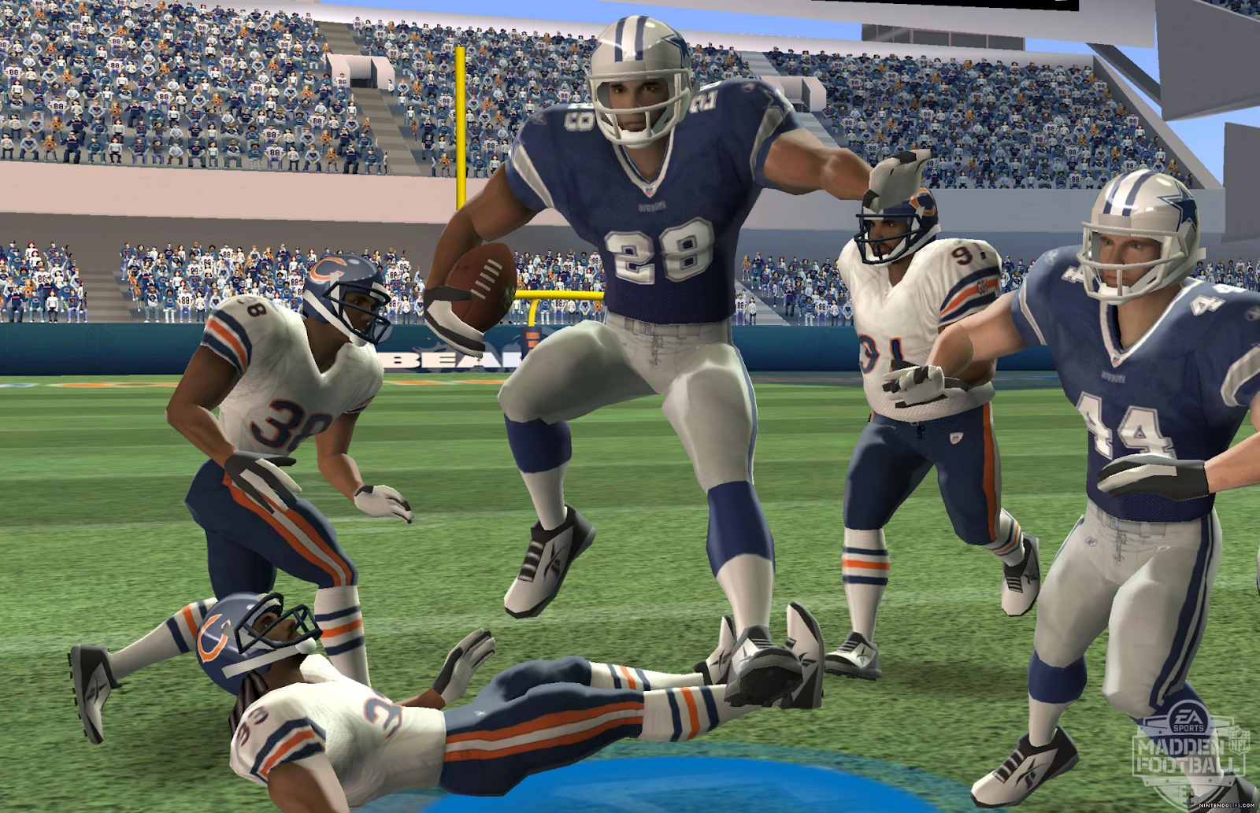
DS501 Project 4 NFL Big Data Bowl
Mia Barger ▪ Quincy Hershey ▪ Alexander Moore ▪ Ethan Prihar

Slide 2
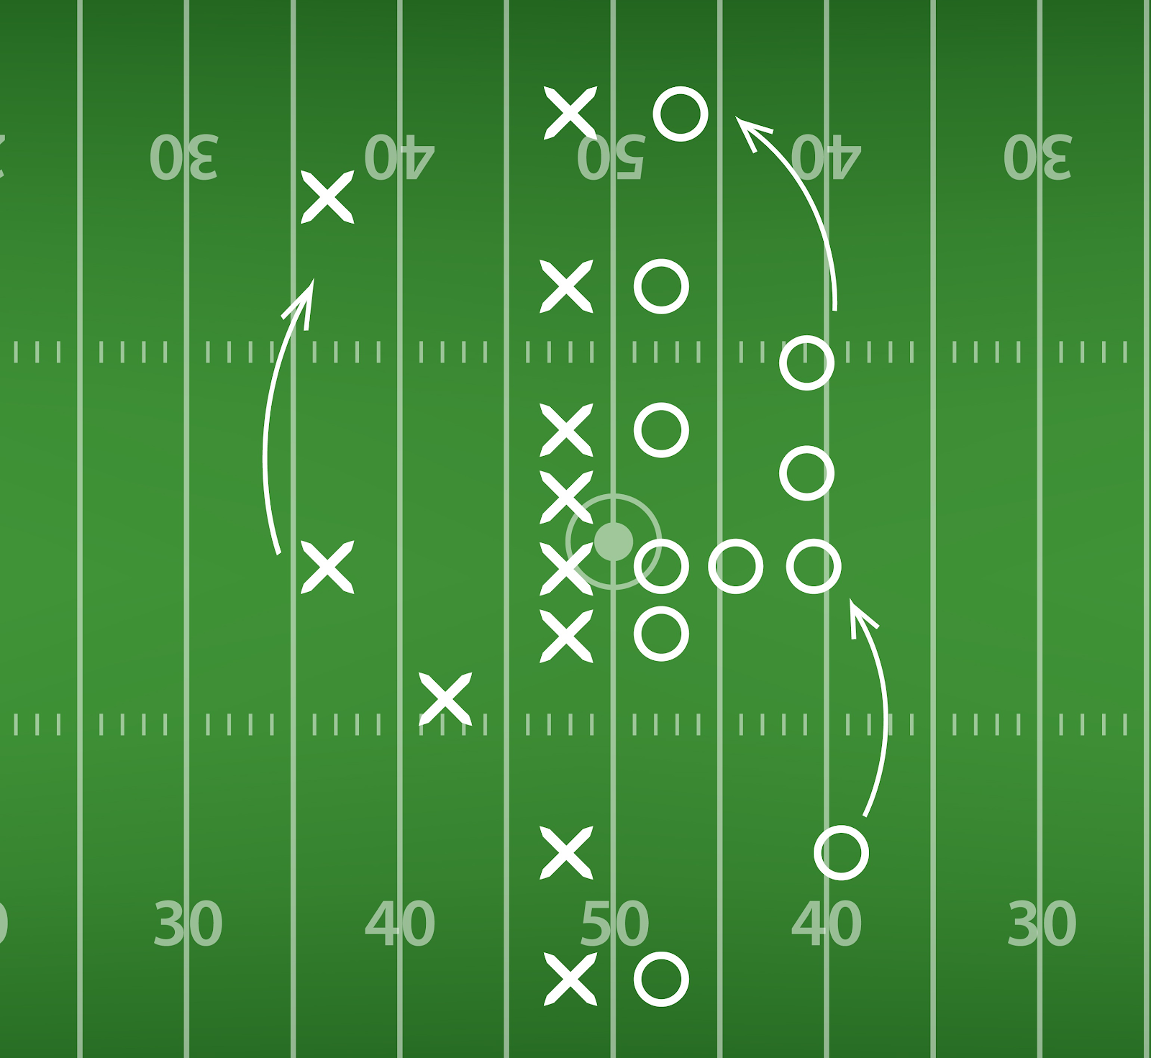
Kaggle Competition to Predict Yardage
Training data of 23,000 rushing plays across 49 features

Slide 3
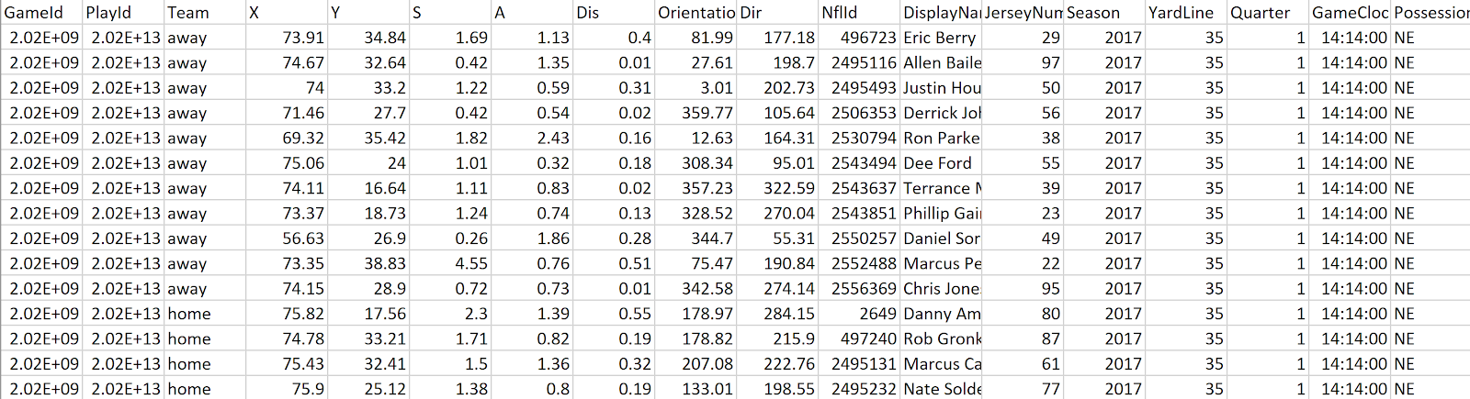
Data Problems
Single features independent to target, complex plays

Slide 4
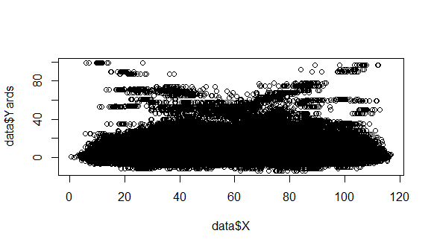
Data Analysis

Slide 5
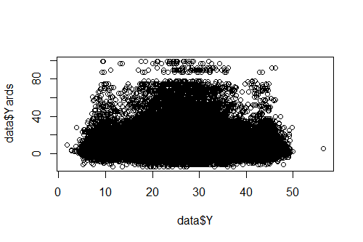
Data Analysis

Slide 6
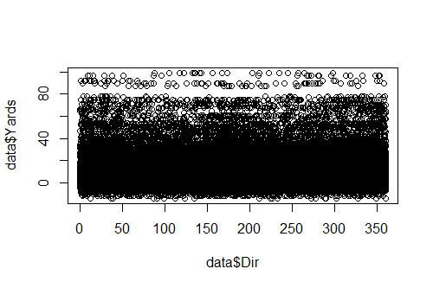
Data Analysis

Slide 7
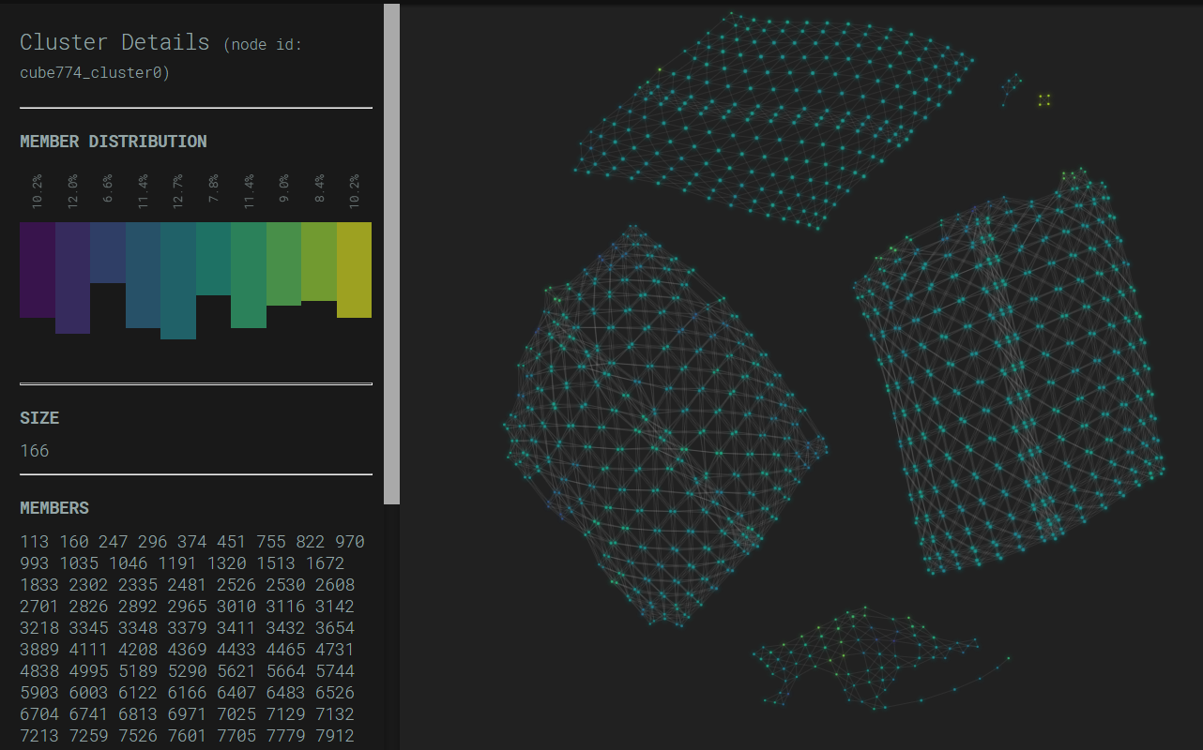
Principal Component Analysis

Slide 8
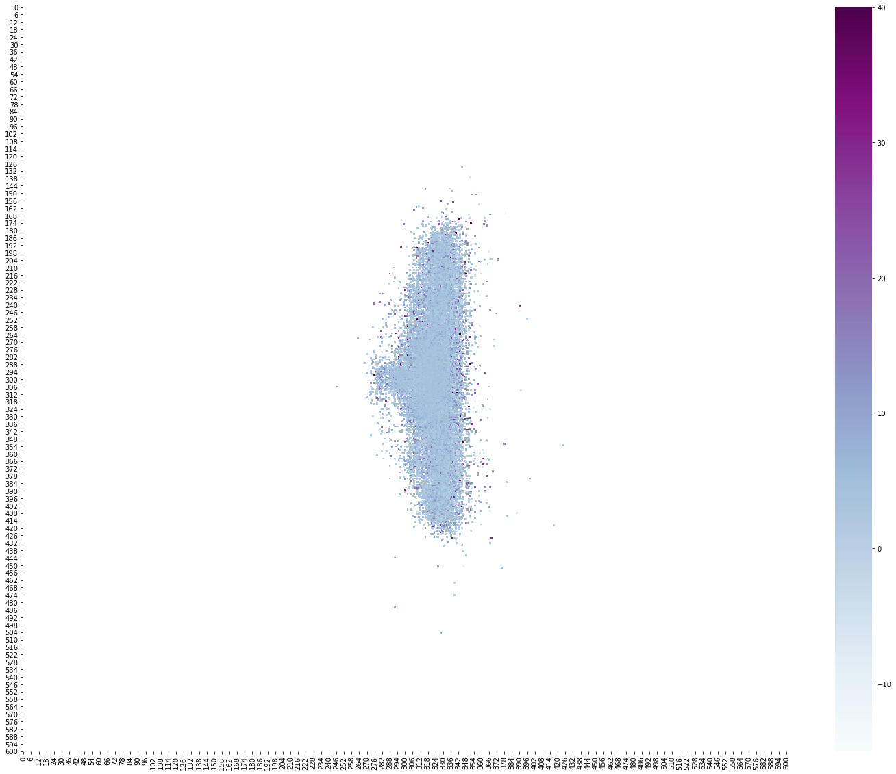
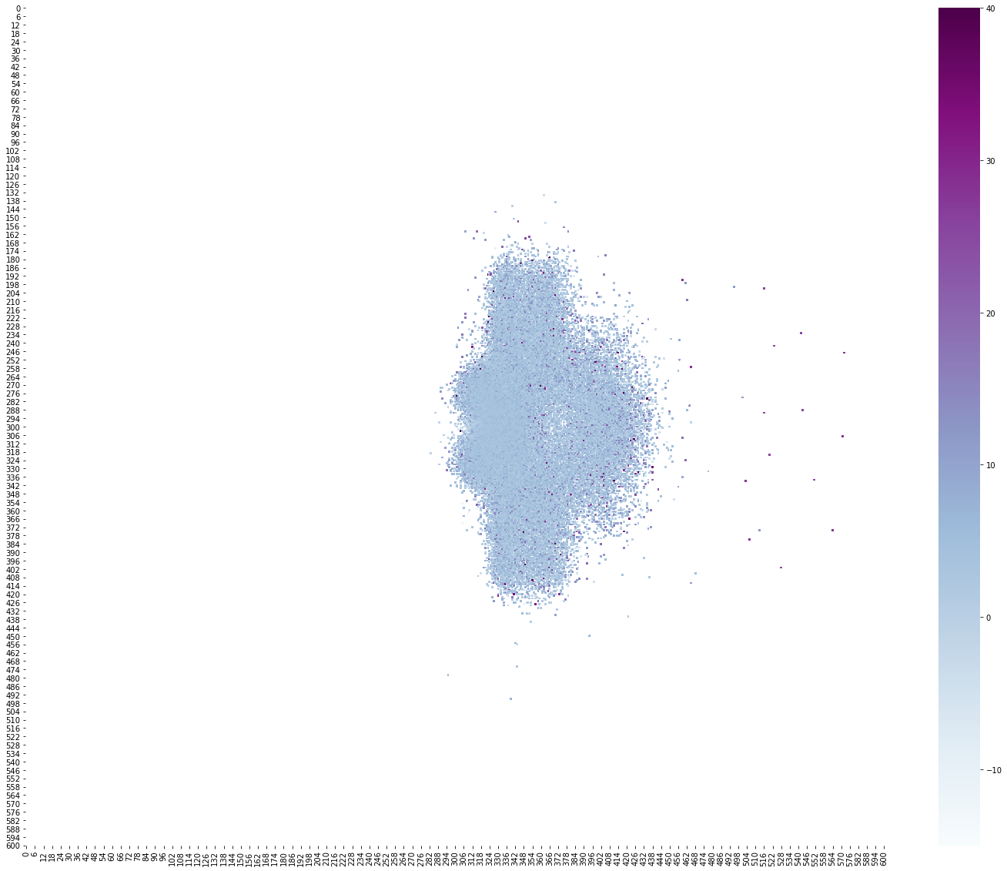
Data Characteristics
Offensive Formations
Defensive Formations

Slide 9
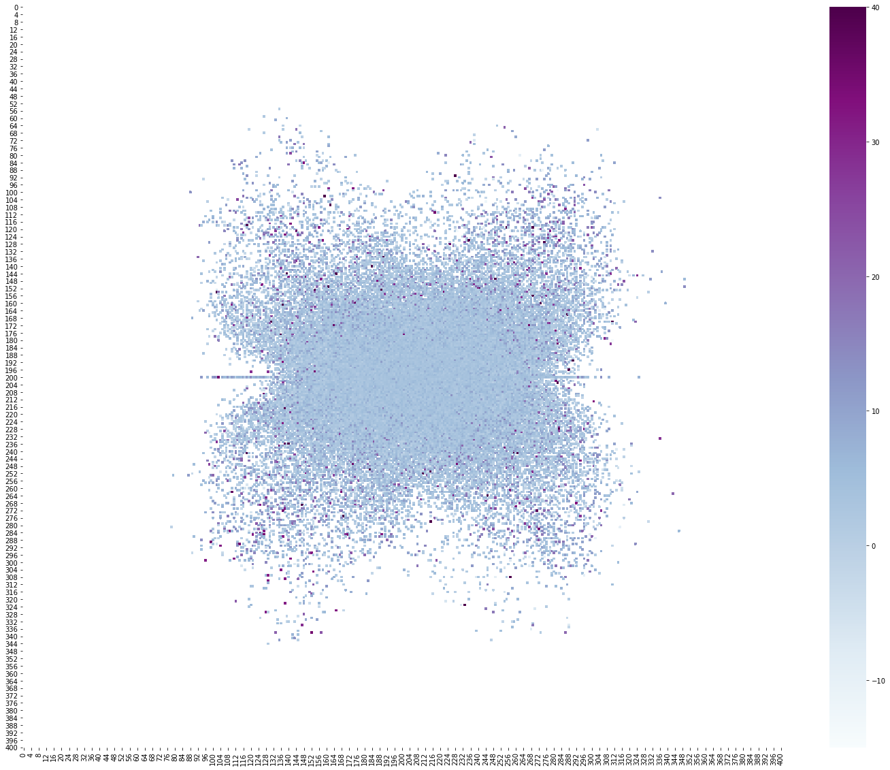
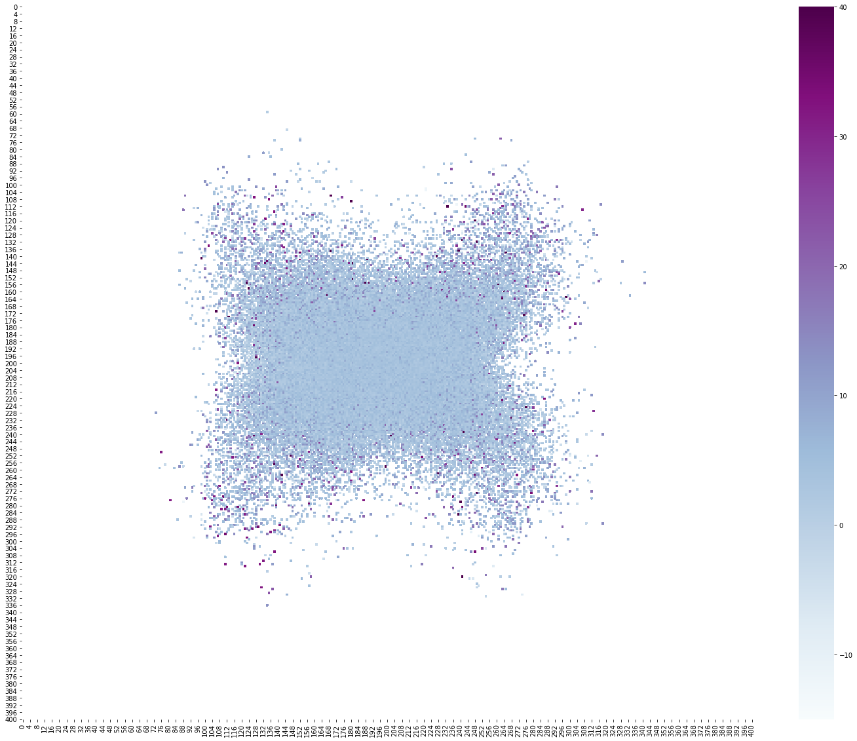
Data Characteristics
Offensive Velocity
Defensive Velocity

Slide 10
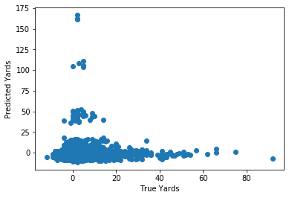
Model Comparison
Model: | Average Value | Linear Regression | Regression Tree | Neural Network
MSE: | 38.01 | 37.24 | 38.73 | 47.88
Most important features
Offensive formation
Defensive backs

Slide 11
Conclusions
Linear regression slightly improved from the zero-r model
Next steps:
Robust feature extraction
Physics model

